Slide 1
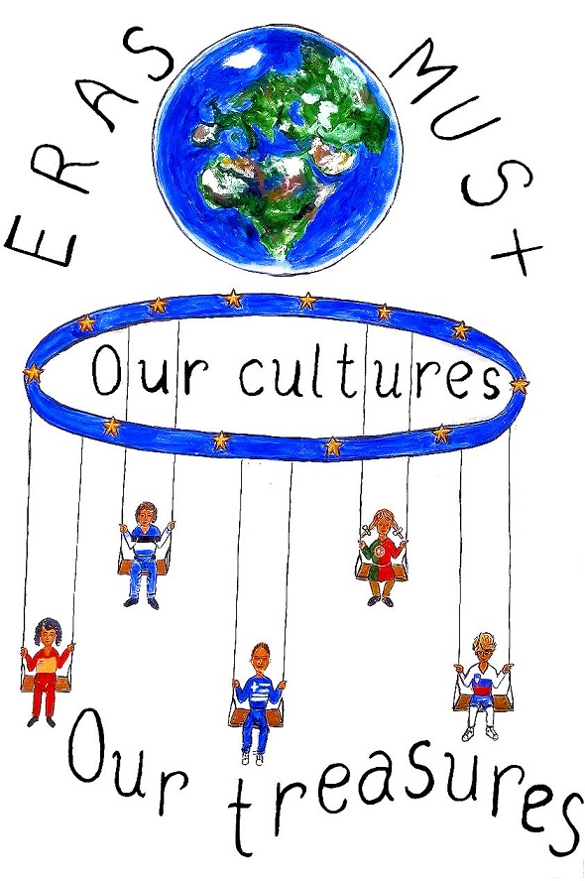

Slide 2
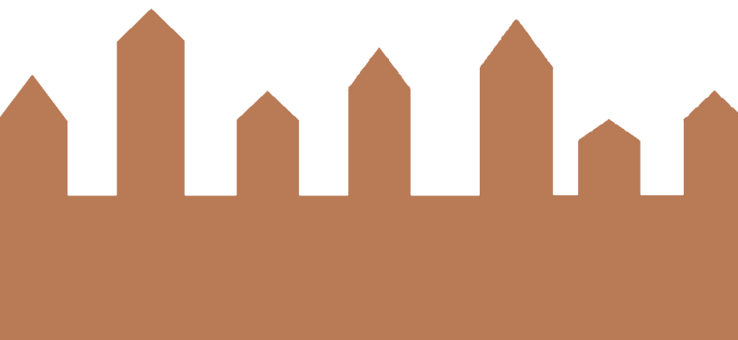
Exibition of our local architectural symbols

Slide 3
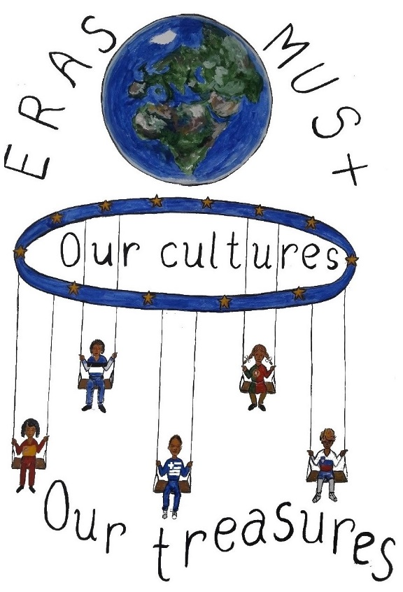
ESTONIA - PÄRNU

Slide 4
Ammende Villa
Villa Ammende is one of the best examples of the early Art Nouveau style in Estonia.

Slide 5
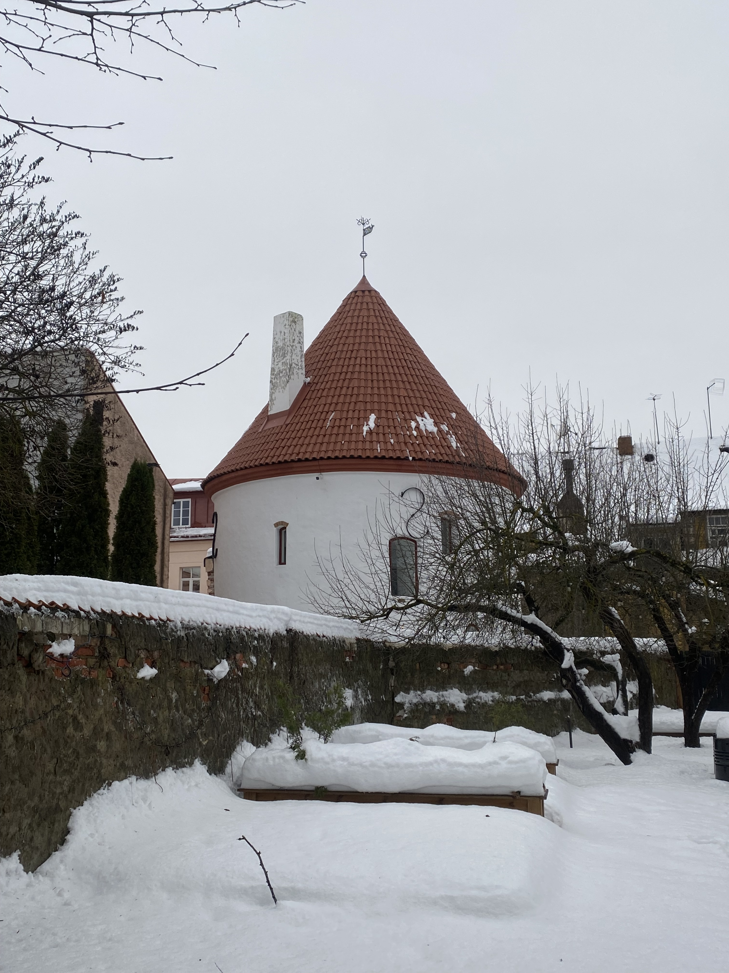
Red Tower
The Red Tower is a part of the medieval fortress of Pärnu, a prison tower built in the South-eastern corner of the city wall in the 15th century.

Slide 6
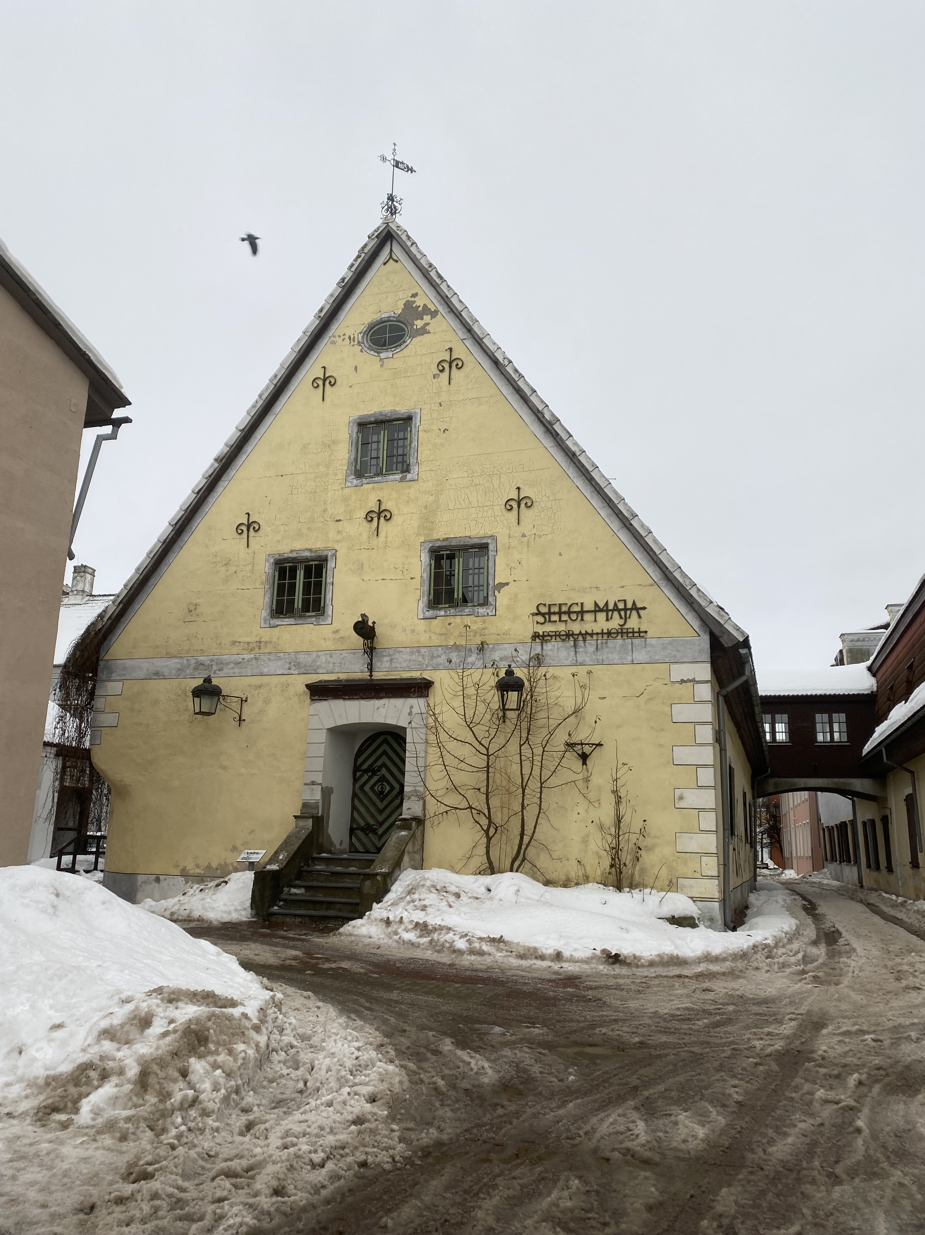
Seegi Maja
(the Almshouse)
Seegi Maja (the Almshouse) is known to be the oldest building in Pärnu. It was built in 1658

Slide 7
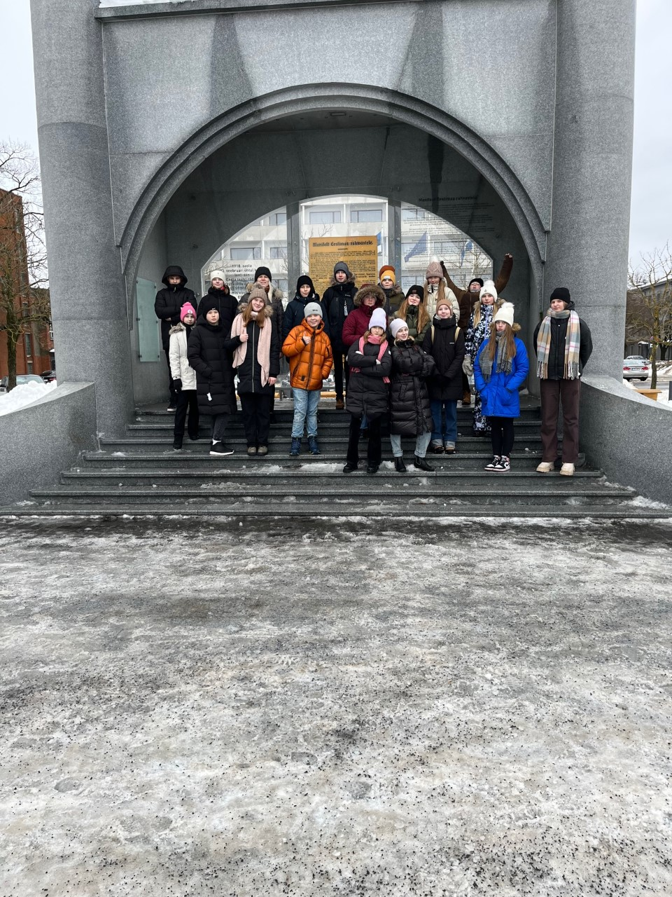
Monument to declaring the independence of the Republic of Estonia
"Manifesto to the Peoples of Estonia" was publicly read out for the first time on February 23, 1918 from the balcony of the Endla Theatre and Society House which stood where Pärnu Hotel is today.

Slide 8
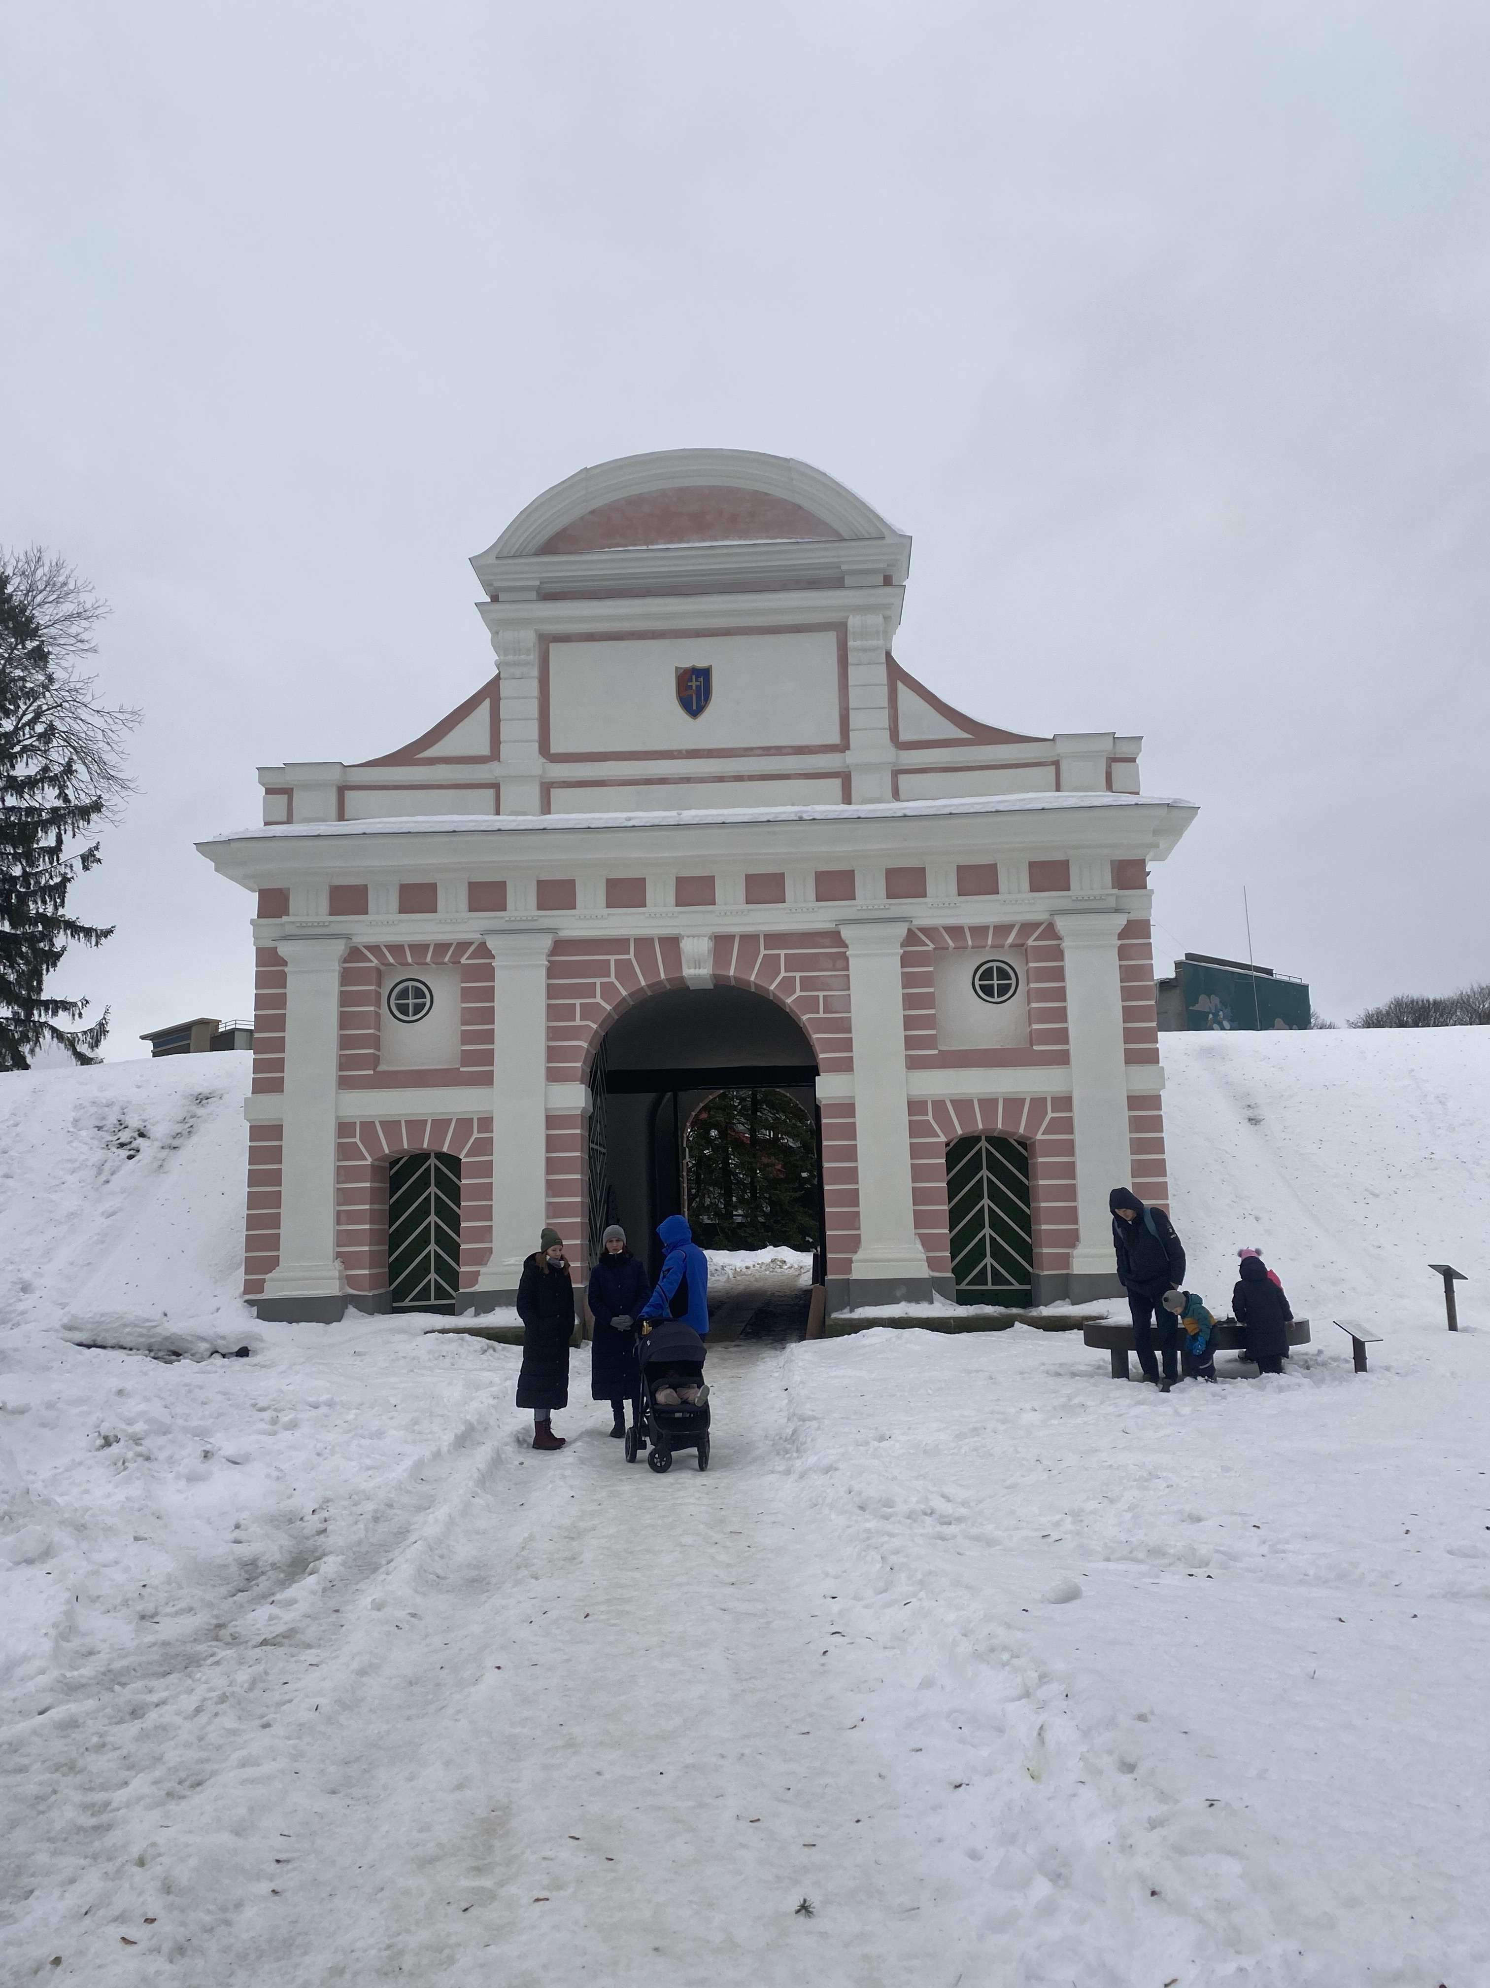
Tallinn Gate
Tallinn gate is the only surviving 17th century gate with an embankment in the Baltic Countries.

Slide 9
GREECE - EDESSA

Slide 10
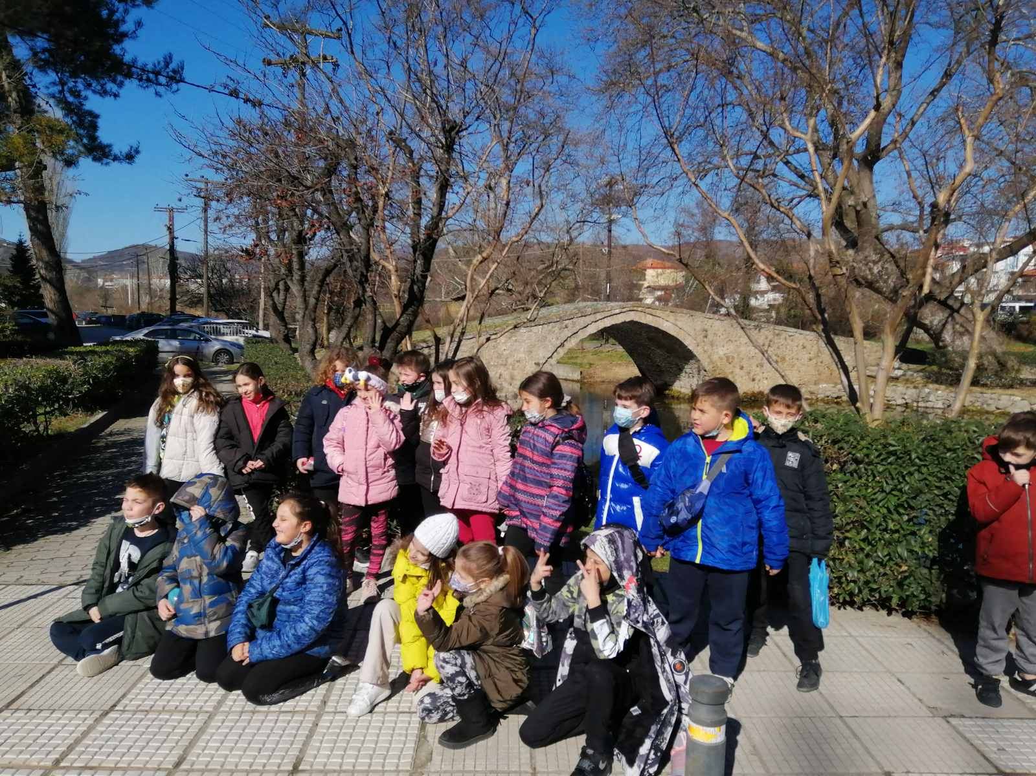
Byzantine Bridge Kioupri

Slide 11
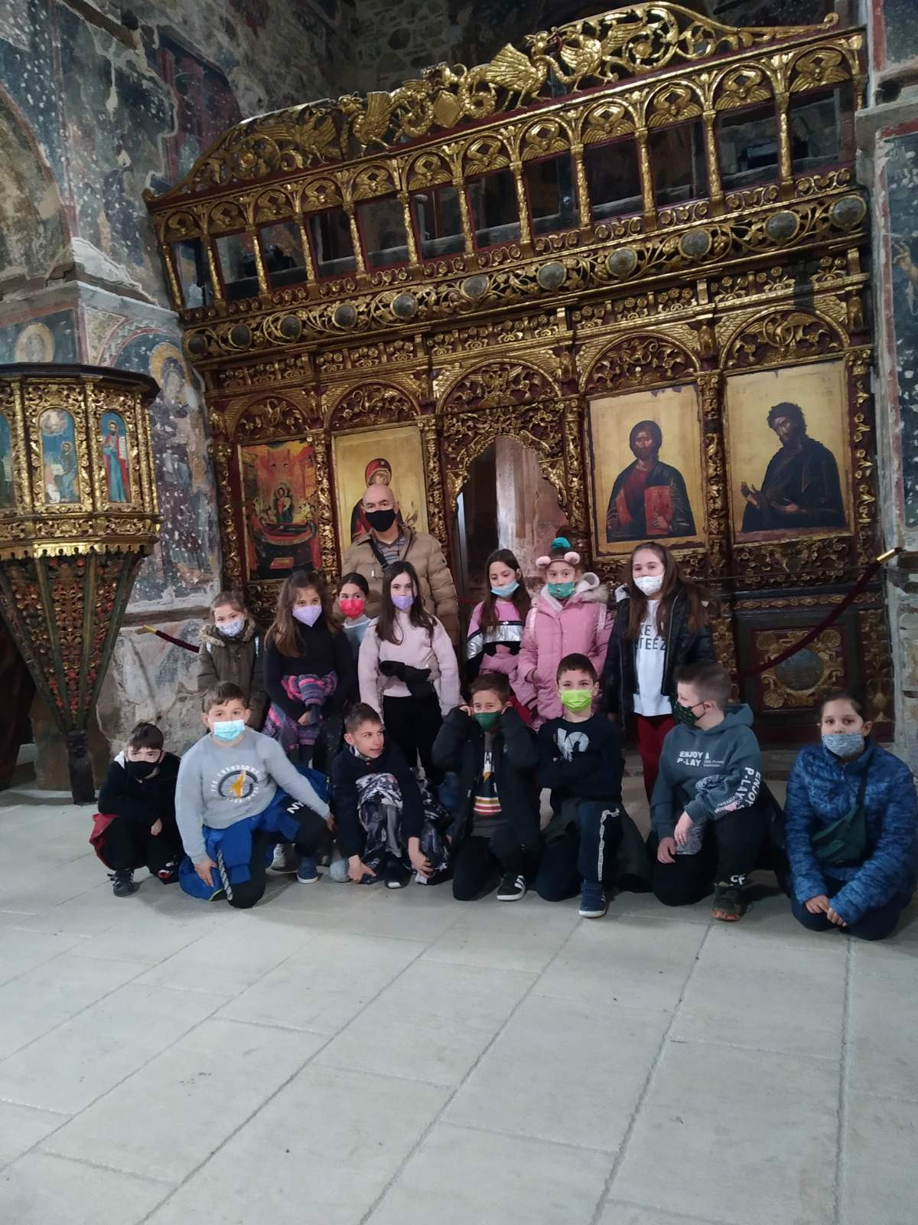
Old cathedral

Slide 12
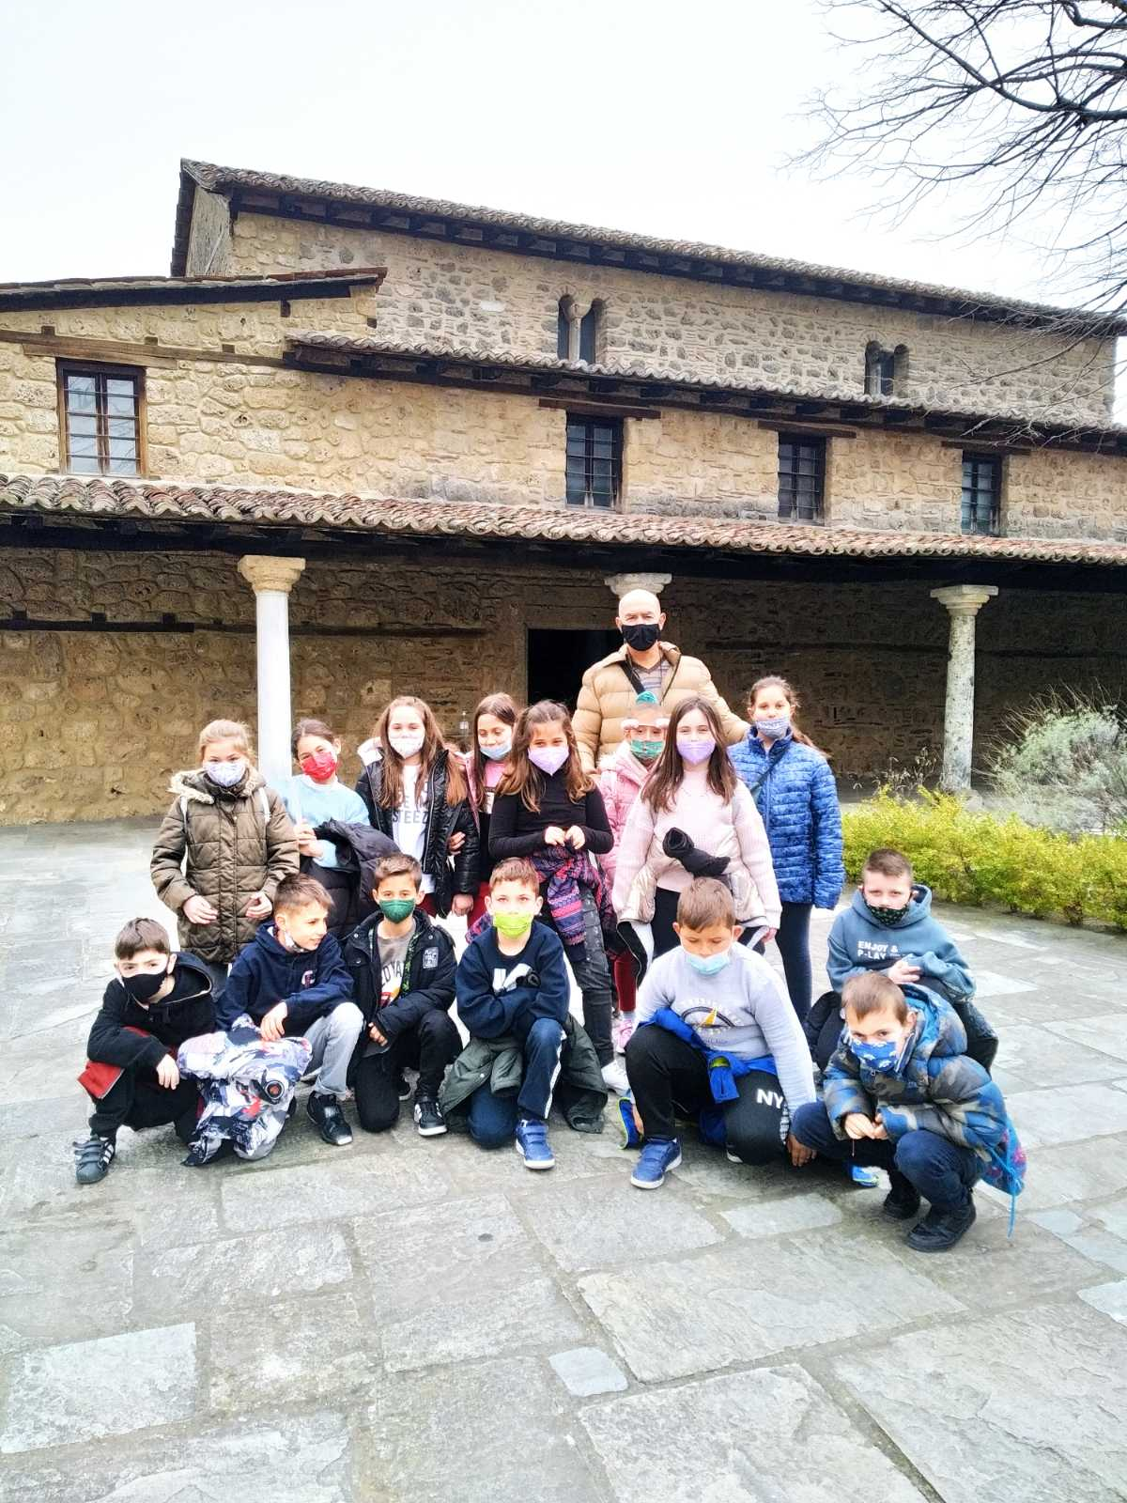
The church of the Assumption

Slide 13
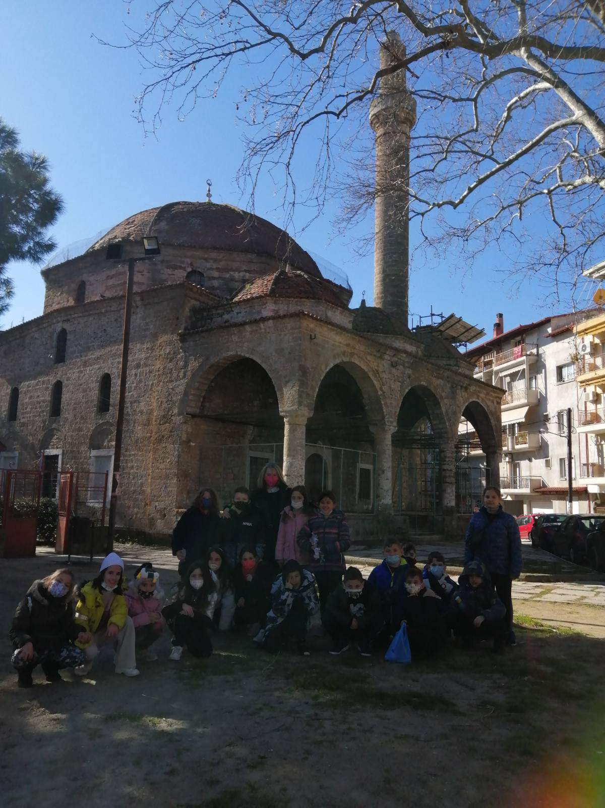
‘Geni’ mosque

Slide 14
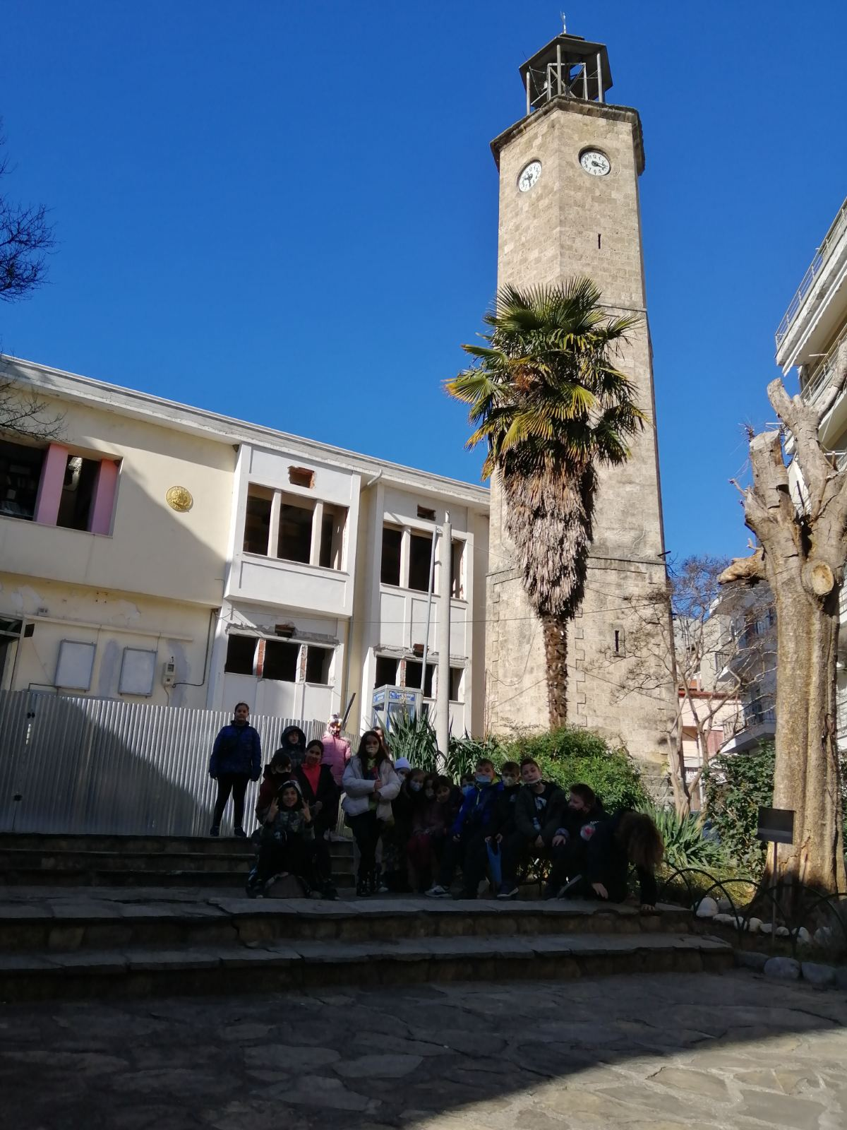
Clock tower

Slide 15
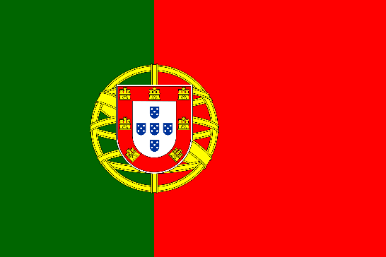
PORTUGAL –
TERCEIRA

Slide 16
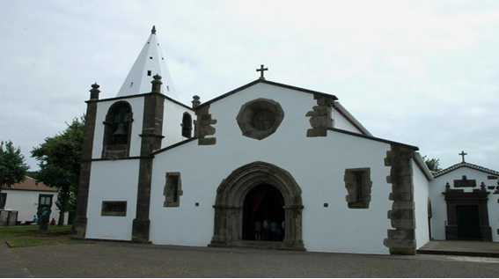
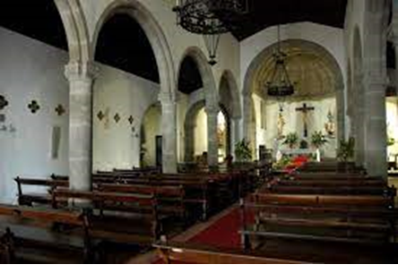
S. Sebastião church

Slide 17
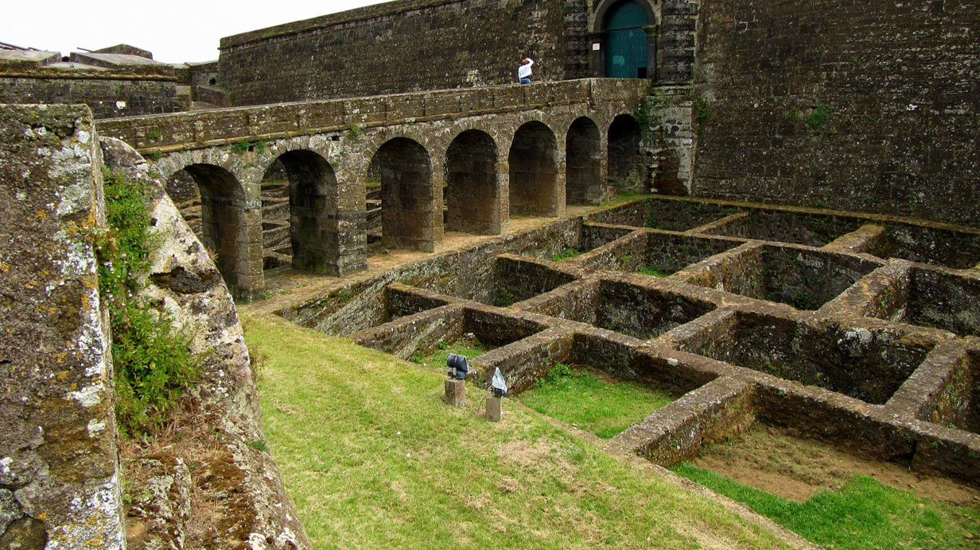
Fortress of S. João Batista

Slide 18
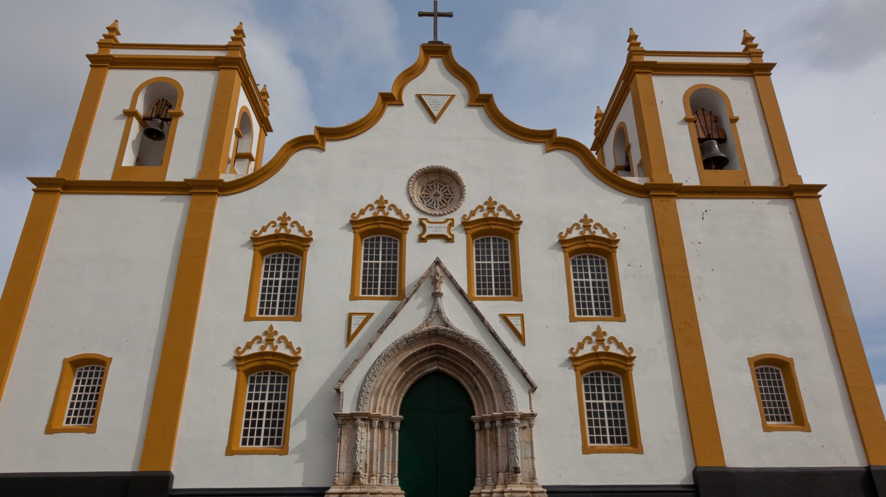
Praia da Vitória church

Slide 19
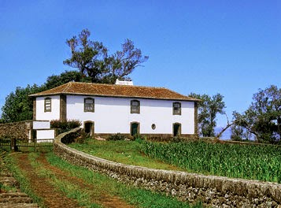
Ramo Grande Houses

Slide 20
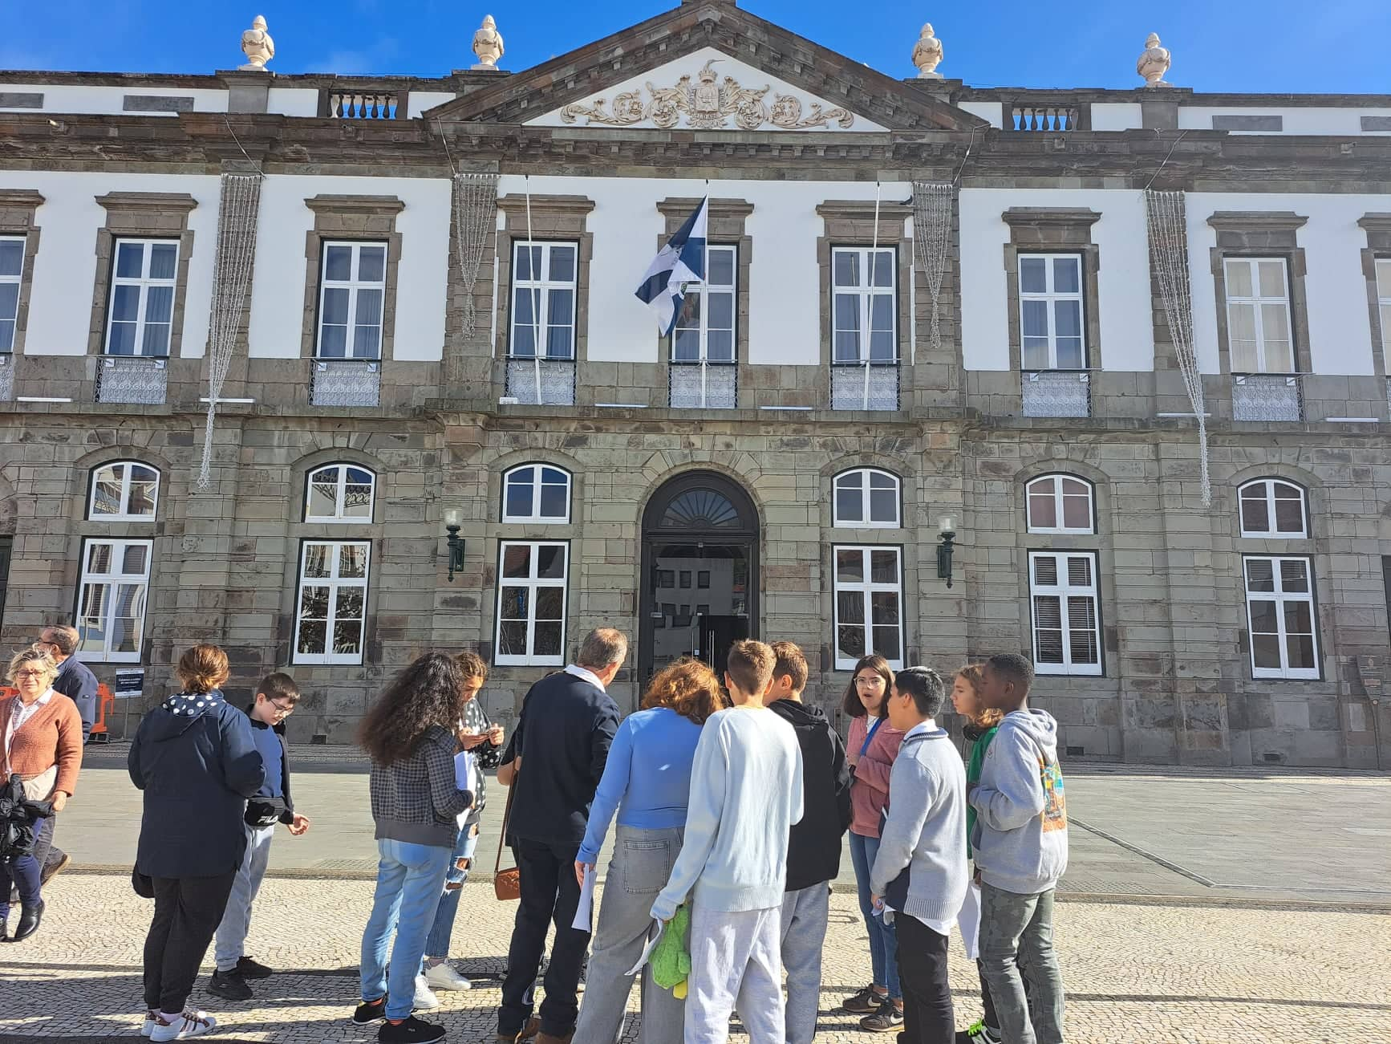
City Hall of Angra do Heroísmo

Slide 21
SLOVENIA –
RAČE – MARIBOR - LJUBLJANA

Slide 22
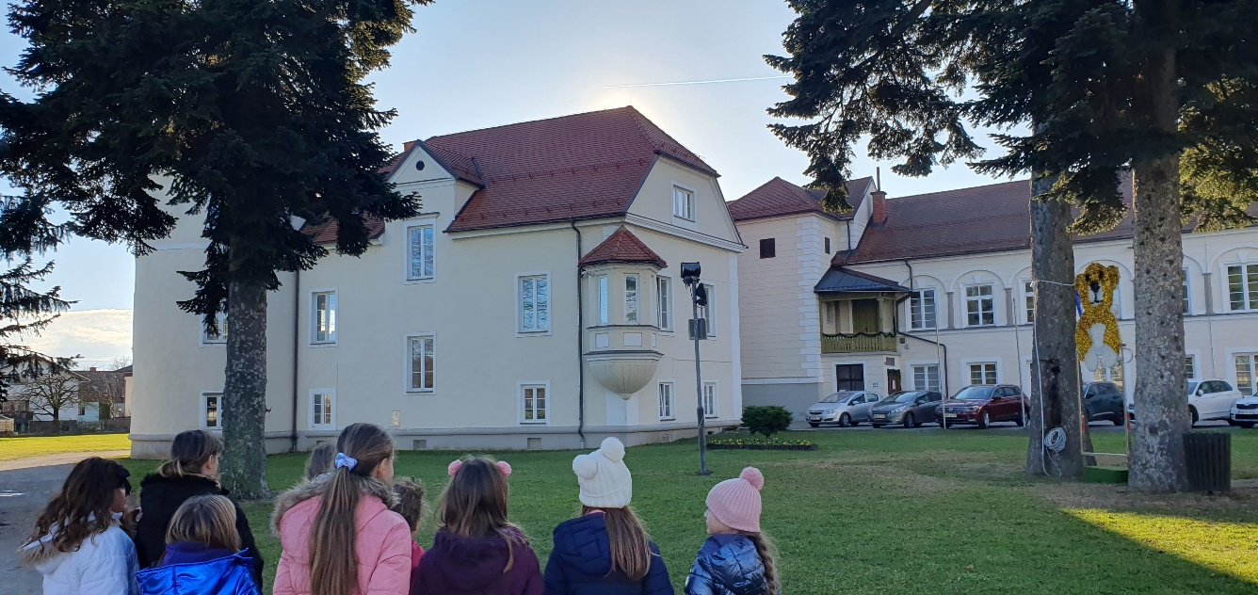
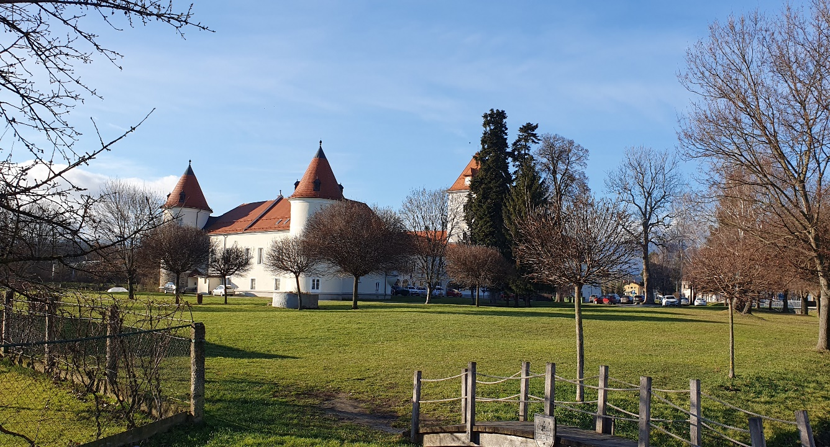
The castle Rače
The castle Rače is a very beautiful castle with two round towers. Its creation dates back to the first half of the 16th century. It is especially interesting because it has the shape of a key.

Slide 23
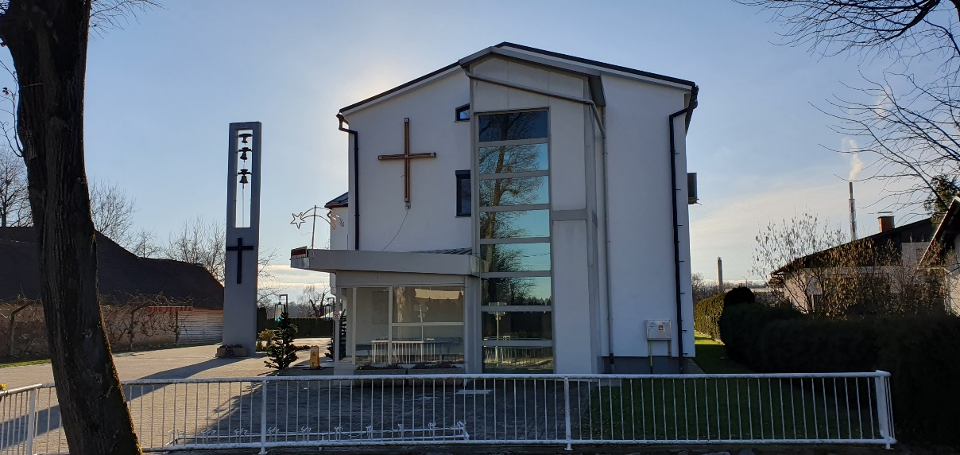
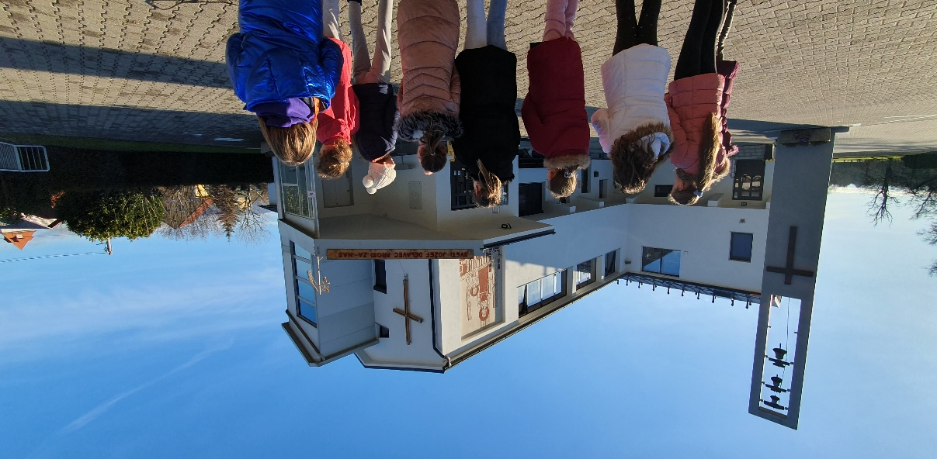
The church in Rače
The church is relatively young, as the original building was built only in 1967. Later it was extended. The church has beautifull colored stained glass windows.

Slide 24
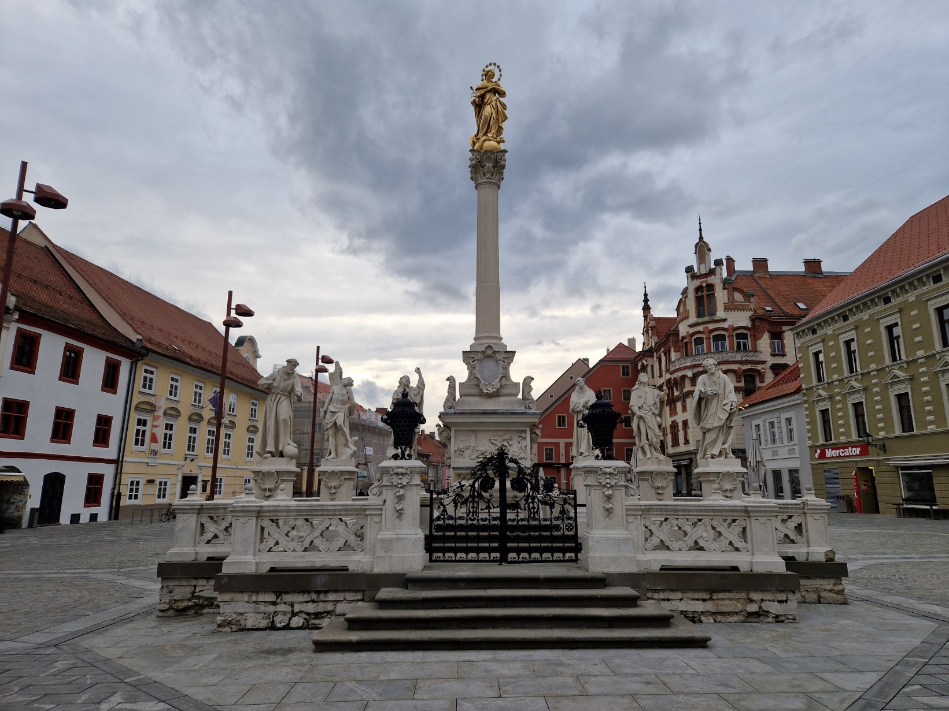
Plague Column in
nearest town Maribor
The plague broke out in Maribor for the first time in the 17th century. Around a third of the infabitants died.
The Plague Column was erected in 1681, when this terrible disease was over.

Slide 25
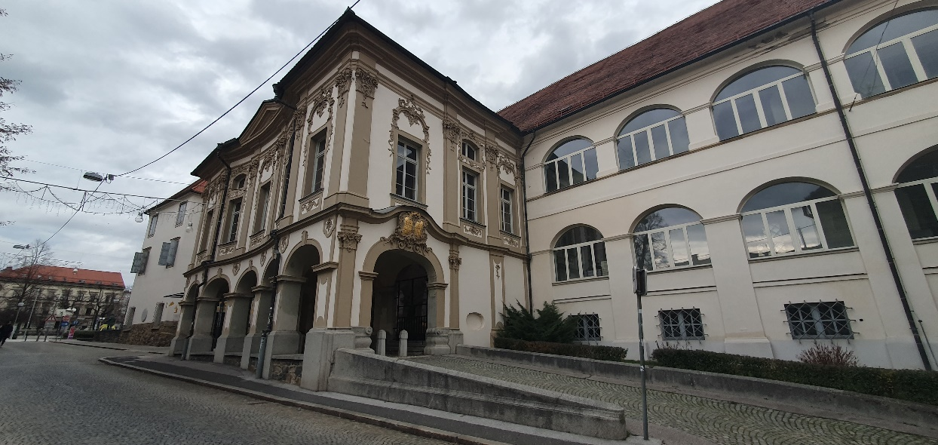
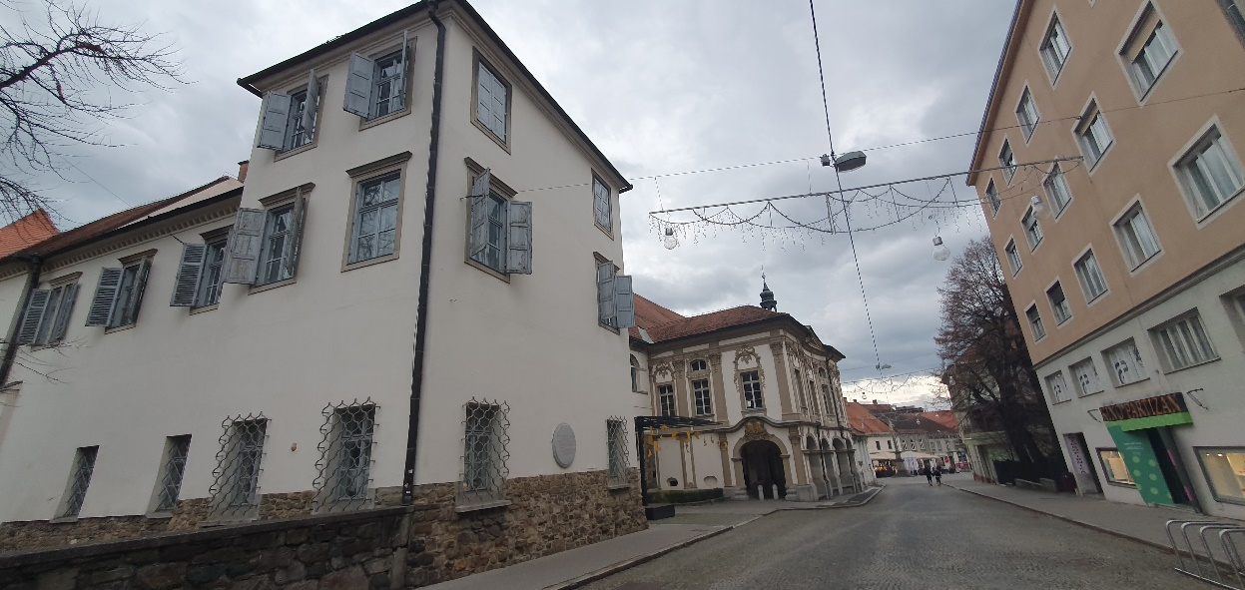
The Maribor Castle
The castle has been built by Emperor Friderik III between the years 1478 and 1483.
At first it was a part of the defensive walls, but later it became an important residence for feudal lords.

Slide 26
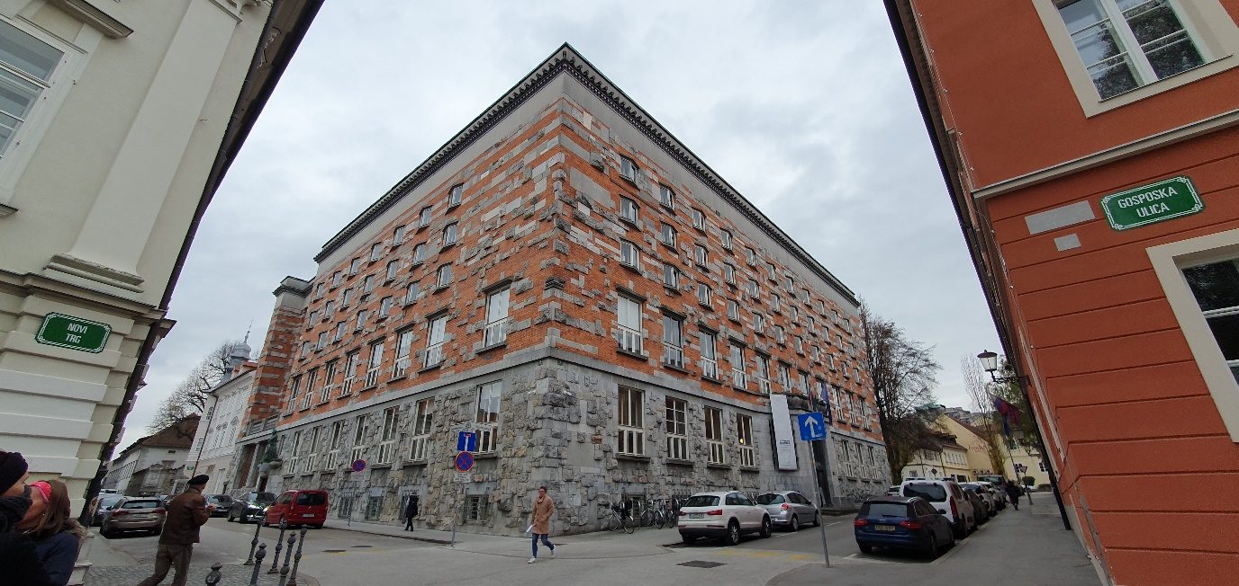
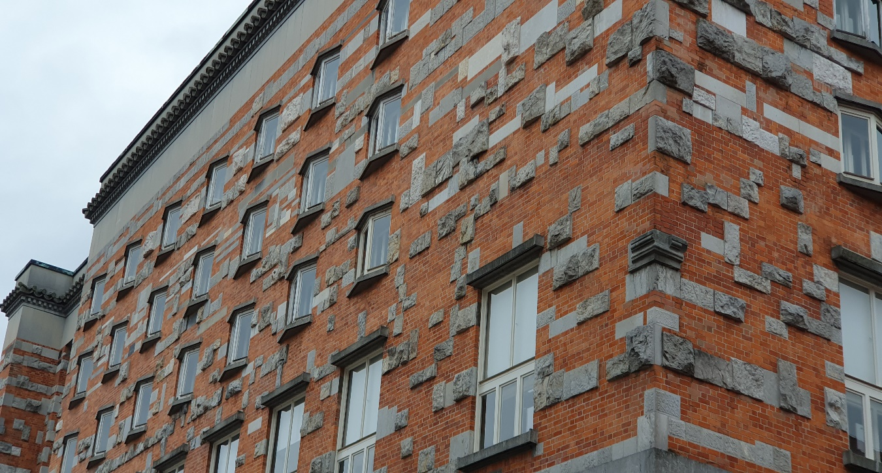
The National and University Library in Ljubljana
The Library Palace in Ljubljana is one of the greatest work of the world-famous Slovenian architect Jože Plečnik.
A lot of details shows you this is a library. Even the windows are in a shape of an open book.

Slide 27
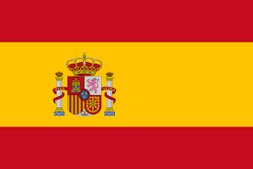
SPAIN - FERROL

Slide 28
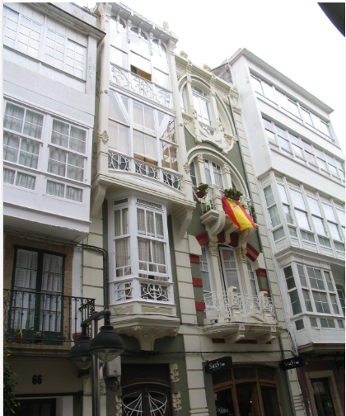
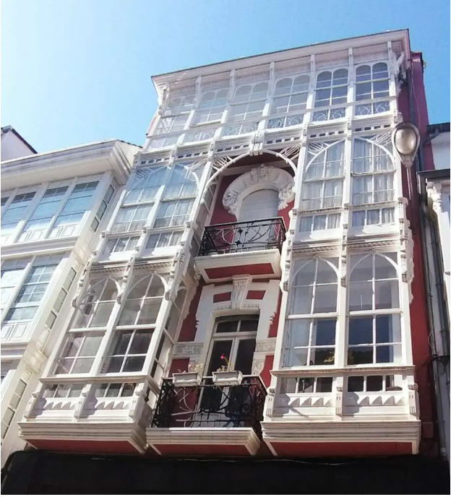
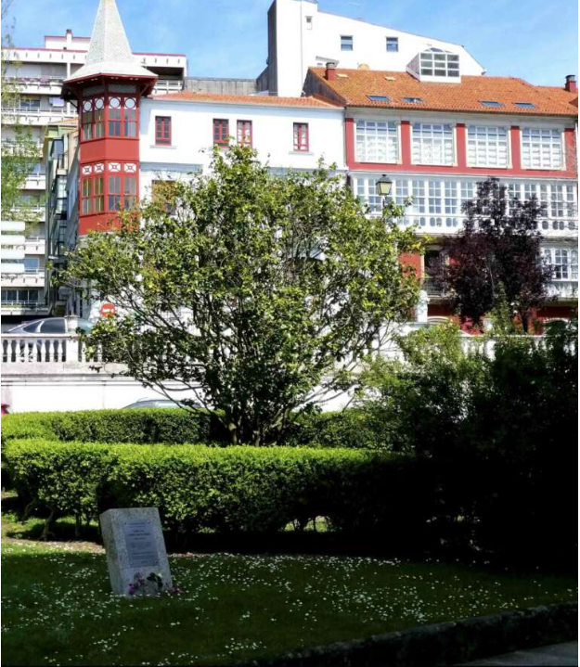
Architecture in Ferrol. Symbols and heritage.
One of the most famous architects from Ferrol is Rodolfo Ucha Piñeiro. He designed buildings that are very similar to Gaudí´s. In Ferrol´s downtown, you can see some of them like Casa Pereira, Casa Rodríguez Trigo, and Chalé de Antón.
Casa Pereira
Casa Rodríguez Trigo
Chalé de Antón

Slide 29
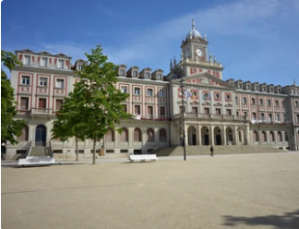
In Ferrol there are two important symbols: the town hall and Jofre theater.
Ferrol‘s Town Hall
It was designed by the architectures Nemesio López Rodríguez and Vicente García Lastra in 1953. It is a Neoclassic building more focused on simplicity and harmony than on decorative ornaments.

Slide 30
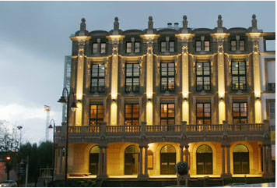
Jofre‘s Theatre
Jofre´s theatre is a building designed by Faustino Domínguez Coumes Gay. His inspiration were the Italian theatres. Its name comes from Joaquín Jofre y Maristany, who gave a significant quantity of money for the construction of the theatre. It was finished in 1892 and the first play performed was “El Alcalde de Zaramea” by Calderón de la Barca.

Slide 31
